Slide 1

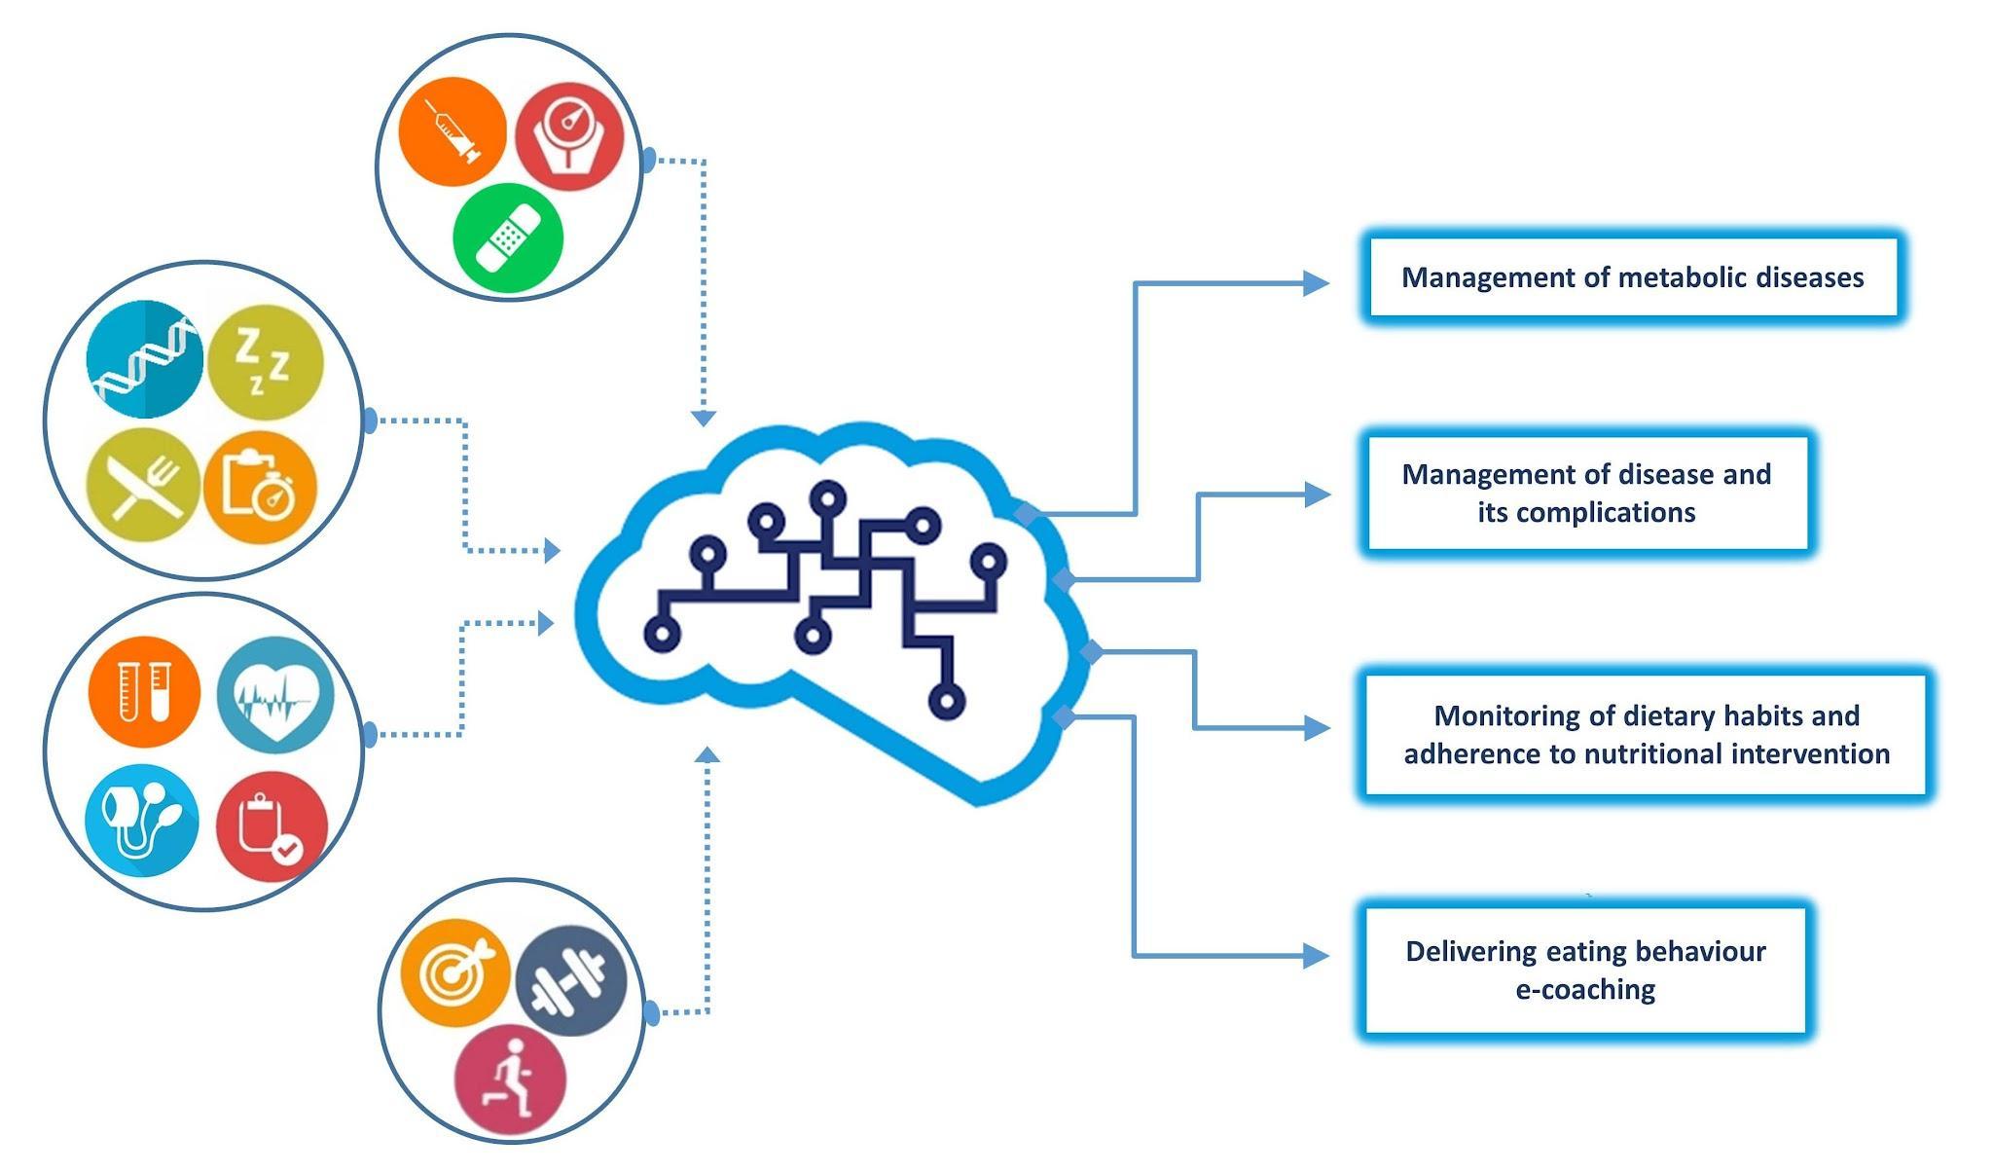

‹#›
Harnessing XGBoost and other techniques for enhanced diabetes diagnosis
Review 3
Name:-Hrishit Madhavi
Panel:-A
PRN:-1032220164
Roll No:-3
Guide:-Prof. Rashmi Rane

Slide 2
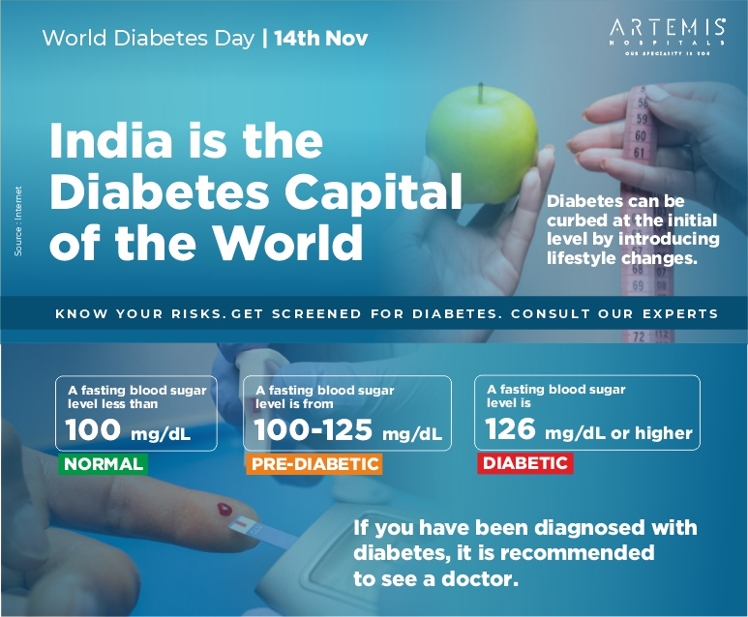

Introduction and Motivation
Introduction and Motivation
Diabetes affects over 500 million patients worldwide and continues to rise.
Introduction
Chronic Disease – Diabetes is a long-term condition that affects how the body processes blood sugar (glucose).
Types – There are two main types:
Type 1 Diabetes – The immune system attacks insulin-producing cells, requiring lifelong insulin therapy.
Type 2 Diabetes – The body becomes resistant to insulin, often linked to lifestyle and genetics.
Objectives
Develop AI driven approach to address diabetes
Bridge the gap between traditional diagnosis and AI-based Model for diabetes

Slide 3

How ML can help address Diabetes?
What is the topic about?
Leveraging AI-powered Data Completion to Improve Diabetes Prediction
AI fills gaps in diabetes-related data caused by missing values, inconsistent records, and time delays using advanced machine learning models.
Importance
In diabetes care, real-time data analysis is crucial for early detection and effective treatment.
Current Limitations:
Missing or incomplete patient data affects accurate predictions.
Delays in diagnosis can lead to complications.
AI based solutions can address this challenges
Relevance in Today's World
Diabetes is becoming more common due to lifestyle and genetic factors.
Healthcare organizations use machine learning to improve early detection and treatment.
Possible use in personalized medicine for better patient care.
Helps doctors make accurate predictions and decisions based on data.

Slide 4
Literature Review
Title | Author | Year | Methodology | Finding
Precision in Diabetes Diagnosis: Harnessing Ensemble Methods in Machine Learning | Sai Pranay Geetla, Ranjith Reddy.S, Siri Chandana Cheedalla | 2024 | The paper presents an ensemble-based approach for diabetes detection, integrating Gradient Boosting, AdaBoost, XGBoost, Random Forest, and CatBoost. It employs data preprocessing, augmentation, and GridSearchCV for hyperparameter tuning, achieving superior accuracy over single-model methods in predictive healthcare analytics. | Lack of advanced feature engineering for optimization.

Slide 5
Title | Author | Year | Methodology | Finding
Diabetes Prediction using Machine Learning Techniques | Mitushi Soni and Dr. Sunita Verma | 2020 | The study applies machine learning techniques, including KNN, SVM, Decision Tree, Logistic Regression, Random Forest, and Gradient Boosting, for diabetes prediction. Data preprocessing handles missing values, and models are trained, tested, and compared for accuracy evaluation and performance optimization. | The study lacks optimal feature selection techniques, impacting model efficiency and interpretability in diabetes prediction.
A Decision Support System for Diabetes Prediction Using Machine Learning and Deep Learning Techniques | Akhtar Jamil,Jawad Rasheed | 2019 | The study compares machine learning and deep learning methods for diabetes prediction, using SVM, Random Forest, and CNN. Data preprocessing includes normalization and splitting. Models are trained, tested, and evaluated for accuracy, with Random Forest achieving the best performance. | Despite using CNN it still lacks behind Random Forest in terms of accuracy.The accuracy can be achieved through DL Hyperparameter

Slide 6
Title | Author | Year | Methodology | Finding
Diabetes Prediction Using Machine Learning | KM Jyoti Rani | 2020 | The study utilizes machine learning techniques, including KNN, Logistic Regression, Random Forest, SVM, and Decision Tree, for diabetes prediction. The dataset undergoes preprocessing, and models are trained, tested, and evaluated. Decision Tree achieves the highest accuracy, demonstrating superior predictive performance. | Achieved Good accuracy of 98% in Decision Tree but it might lead to overfitting
Diabetes Prediction using Machine Learning Algorithms | Aishwarya Mujumdara , Dr. Vaidehi | 2019 | The methodology includes dataset collection, preprocessing, and applying Logistic Regression, Random Forest, AdaBoost, and K-means clustering, with pipeline modeling optimizing accuracy using evaluation metrics for diabetes prediction | Overall accuracy is high, but recall for diabetic cases is poor. Might be due to high false negatives

Slide 7
Title | Author | Year | Methodology | Finding
Prediction of Diabetes using Classification Algorithms | Deepti Sisodia Dilip Singh Sisodia | 2021 | The study applies Decision Tree, SVM, and Naïve Bayes classifiers for diabetes prediction. Data preprocessing includes handling missing values and normalizing attributes. Performance is evaluated using accuracy, precision, recall, and F-measure, with Naïve Bayes achieving the highest accuracy of 76.30%. | If hyperparameter techniques like bagging,boosting is used the model can achieve good accuracy
Unveiling diabetes onset: Optimized XGBoost with optimization for enhanced prediction | Mohammed Shahbaz Khan, Ashit Kumar Dutta | 2025 | The study employs an optimized XGBoost model with hyperparameter tuning for diabetes prediction. Data preprocessing includes cleaning, scaling, and encoding. Performance is evaluated using accuracy, F1-score, recall, and precision, with optimization improving model efficiency compared to other models. | The study used XGBoost with bayesian tuning to achieve good accuracy of 98%

Slide 8
Title | Author | Year | Methodology | Finding
Diabetes prediction using machine learning and explainable AI techniques | I. Tasin, T. Ullah, N. Sanjida, and I. R. Khan | 2022 | Machine Learning models (e.g., Decision Trees, Random Forest) + Explainable AI (XAI) tools like SHAP | Achieved high accuracy in prediction and enhanced model transparency through XAI methods
Diabetes prediction using ensembling of different machine learning classifiers | K. Hasan, A. Alam, D. Das, E. Hossain, and M. Hasan | 2020 | Ensemble Learning (e.g., Bagging, Boosting, Voting Classifier) | Ensemble models outperformed individual models in terms of accuracy, precision, and recall
Deep learning approach for diabetes prediction using PIMA Indian dataset | H. Naz and S. Ahuja | 2020 | Deep Learning (ANN/MLP on PIMA Indian Dataset) | Achieved better prediction performance compared to traditional ML models using deep neural networks

Slide 9
Research Gaps
1] Lack of Feature Engineering – Some studies do not explore sophisticated feature selection techniques, which could enhance model efficiency and interpretability.
2] Susceptibility to Overfitting – Certain models, like Decision Trees, achieve high accuracy but overfit, reducing generalizability to new data.
3] Limited Robustness to Imbalanced Datasets – Most studies do not address class imbalance, which can lead to poor detection of minority-class cases.
4] Absence of Hyperparameter Tuning – If some studies used hyperparameter tuning that it can give better model result
5] Poor Data-Preprocessing Techniques– If better preprocessing techniques are used to clean dataset then we can remove outlier.

Slide 10
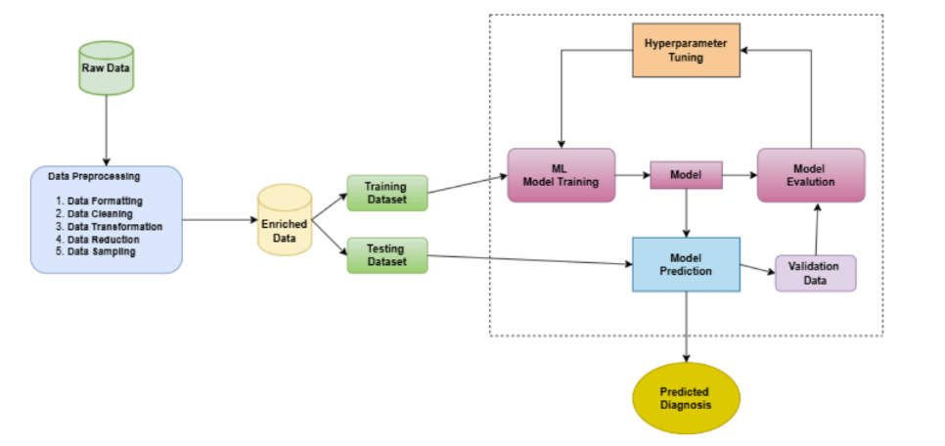
Methodology

Slide 11
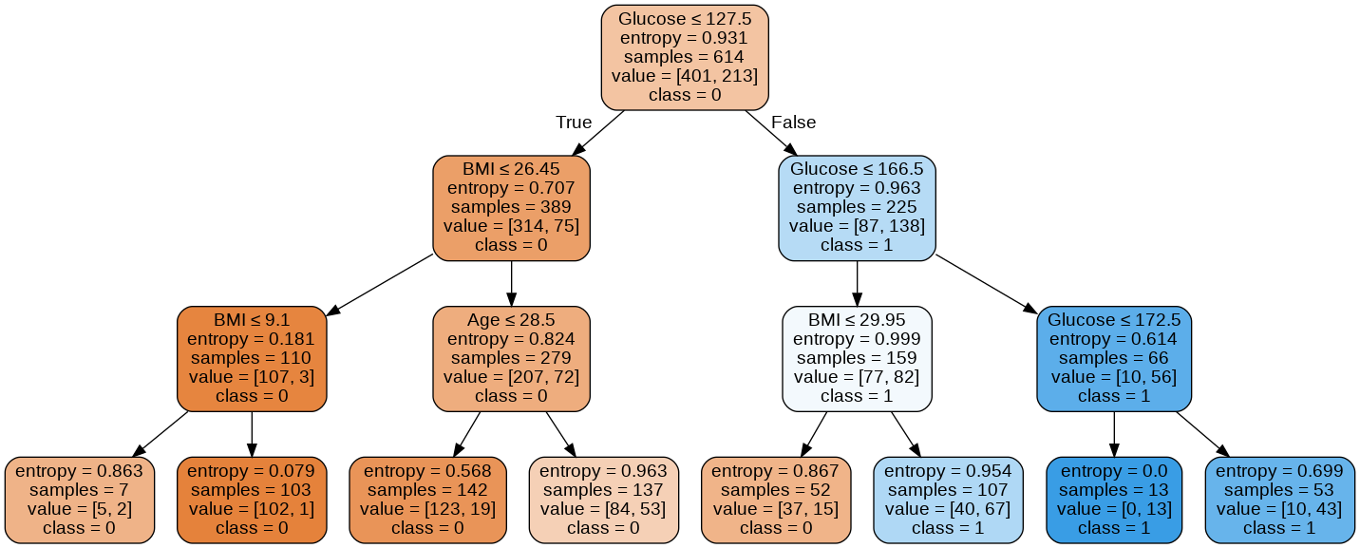
Models Used
K-Nearest Neighbors (KNN): A simple, instance-based algorithm that classifies data points based on the majority label among their 'k' closest neighbors.
Decision Tree: A model that splits data into branches based on feature values, forming a tree-like structure to make decisions or predictions.
XGBoost: An optimized gradient boosting algorithm that builds strong predictive models by combining multiple weak learners, known for speed and accuracy.
CatBoost: A gradient boosting algorithm developed by Yandex, designed to handle categorical features efficiently and reduce overfitting.
Fig:- Decision Tree

Slide 12
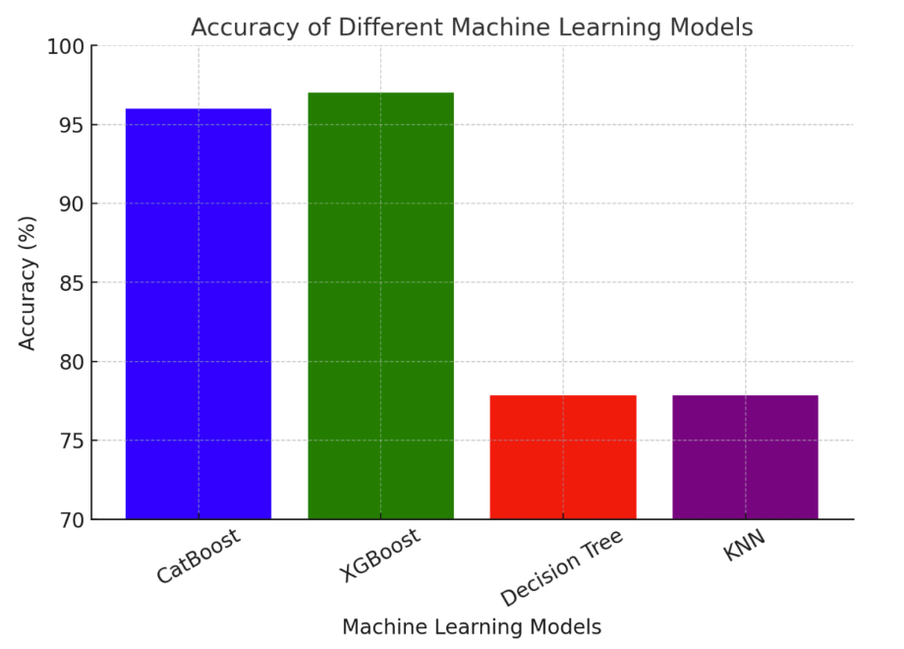
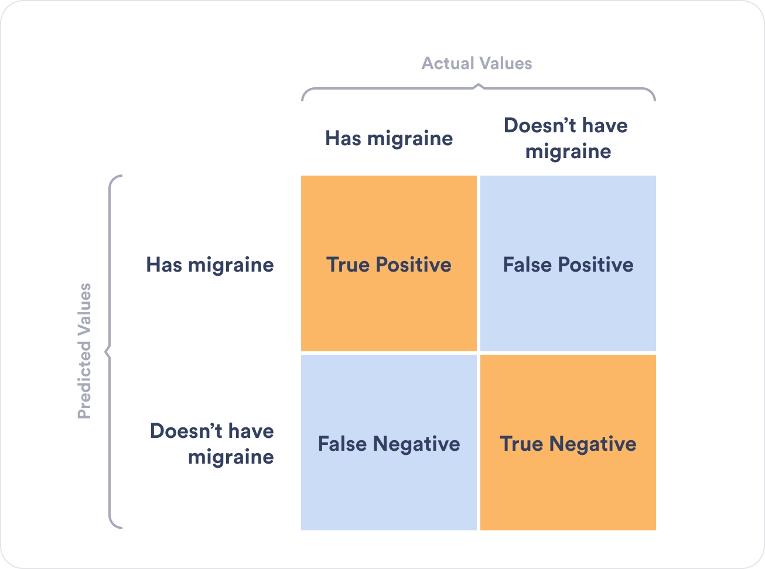
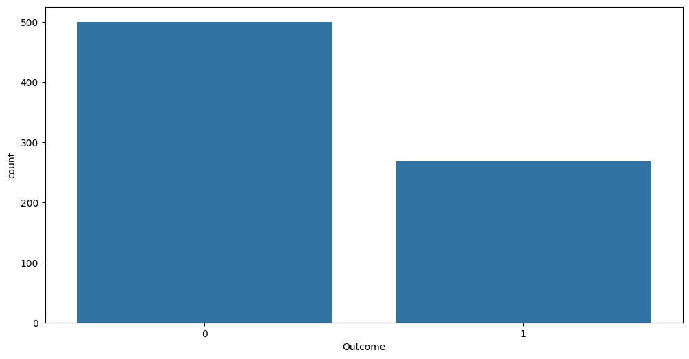
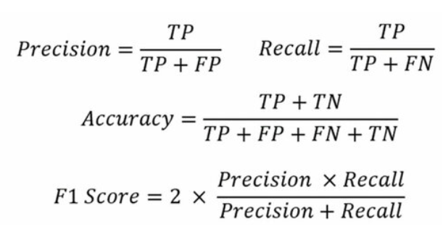
Result & Observation
Based on the evaluation metrics, it was found that XGBoost achieved the highest accuracy of 97%, followed closely by CatBoost at 96%, while KNN and Decision Tree lagged behind with accuracies of 77.84% and 74.86% respectively.
KNN and Decision Tree lagged behind due to their sensitivity to noise and limited ability to handle complex data unlike models like XGBoost and CatBoost.
XGBoost and CatBoost are less likely to overfit due to built-in regularization and advanced boosting techniques, especially when properly tuned.

Slide 13
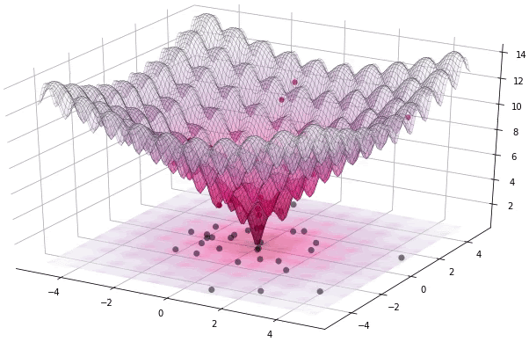

Challenges
Data Availability and Quality Finding clean, labeled, and relevant datasets was challenging and sometimes affected model training and evaluation quality.
Model Selection Complexity Choosing the right algorithm required extensive experimentation, balancing between performance, speed, and interpretability.
Hyperparameter Tuning Tuning parameters for models like XGBoost and CatBoost was time-consuming
High Computational Requirements Training complex models on large datasets demanded significant computing power, which limited experimentation on resource-constrained systems.

Slide 14





Application
Early Diagnosis & Screening – ML models help detect diabetes risk early, enabling preventive measures and timely medical intervention.
Personalized Treatment Plans – AI-driven models analyze patient data to recommend tailored treatment strategies for better disease management.
Remote Monitoring & Wearable Integration – ML-powered apps track real-time health metrics from wearables, aiding continuous glucose monitoring.
Automated Risk Identification – ML classifies patients into risk categories, assisting doctors in prioritizing high-risk individuals for intervention.
Integration with Continuous Glucose Monitors

Slide 15

Conclusion
ML aids diabetes prediction, but full reliance is risky. Human expertise is crucial for accurate diagnosis, treatment, and decision-making.

Slide 16
References
M. R. Khurshid et al., "Unveiling diabetes onset: Optimized XGBoost with Bayesian optimization for enhanced prediction," PloS One, vol. 20, no. 1, p. e0310218, 2025.
S. P. Geetla et al., "Precision in diabetes diagnosis: Harnessing ensemble methods in machine learning," in 2024 OPJU Int. Technol. Conf. (OTCON) on Smart Computing for Innovation and Advancement in Industry 4.0, IEEE, 2024.
S. K. S. Modak and V. K. Jha, "Diabetes prediction model using machine learning techniques," Multimedia Tools and Applications, vol. 83, no. 13, pp. 38523–38549, 2024.
A. Mujumdar and V. Vaidehi, "Diabetes prediction using machine learning algorithms," Procedia Computer Science, vol. 165, pp. 292–299, 2019.
M. Soni and S. Varma, "Diabetes prediction using machine learning techniques," International Journal of Engineering Research & Technology (IJERT), vol. 9, no. 09, pp. 2278–0181, 2020.
K. J. Rani, "Diabetes prediction using machine learning," International Journal of Scientific Research in Computer Science, Engineering and Information Technology, vol. 6, pp. 294–305, 2020.
A. Yahyaoui et al., "A decision support system for diabetes prediction using machine learning and deep learning techniques," in 2019 1st Int. Informatics and Software Engineering Conf. (UBMYK), IEEE, 2019.
I. Tasin, T. Ullah, N. Sanjida, and I. R. Khan, "Diabetes prediction using machine learning and explainable AI techniques," Healthcare Technology Letters, 2022. DOI: 10.1049/htl2.12039.
K. Hasan, A. Alam, D. Das, E. Hossain, and M. Hasan, "Diabetes prediction using ensembling of different machine learning classifiers," IEEE Access, 2020. DOI: 10.1109/ACCESS.2020.2989857.
H. Naz and S. Ahuja, "Deep learning approach for diabetes prediction using PIMA Indian dataset," Journal of Diabetes & Metabolic Disorders, 2020. DOI: 10.1007/s40200-020-00520-5.

Slide 17


